Slide 1

When VBLora meets Federated Learning
Kaiyang Li

Slide 2
Outline
LoRA:
Low-Rank Adaptation of Large Language Models
VB-LoRA
Extreme Parameter Efficient Fine-Tuning with Vector Banks
Our method
How to adapt VB-Lora to fit Fedearted Learning?
Experiments
Accuracy
Rate of convergence
Future Work

Slide 3
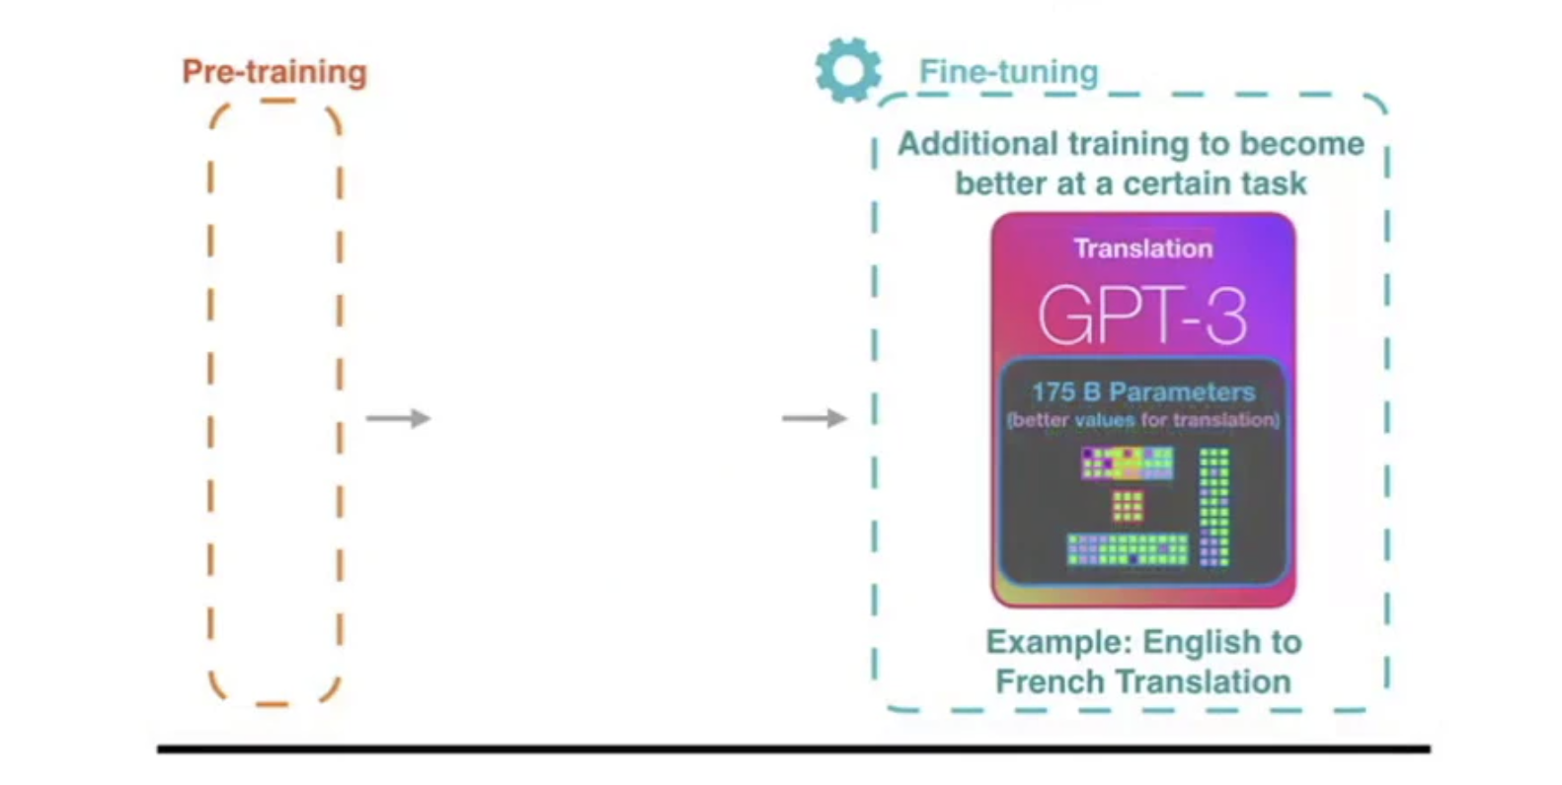
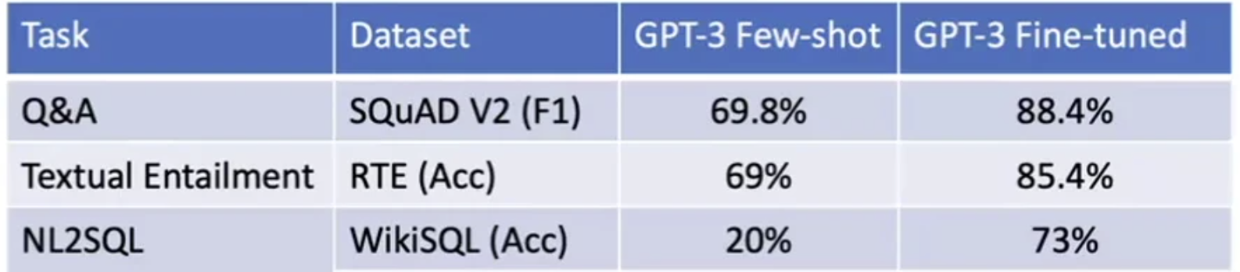
LLM needs fine-tuning

Slide 4
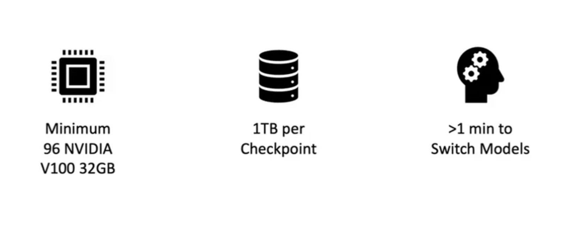
Fine-tune GPT-3 is a nightmare

Slide 5
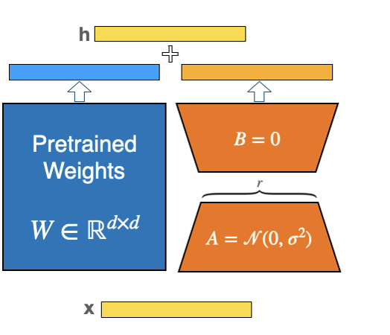
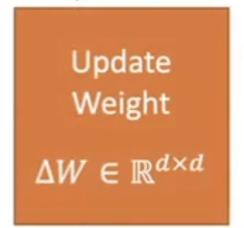
Low-Rank Adaptaion (Lora)

Slide 6
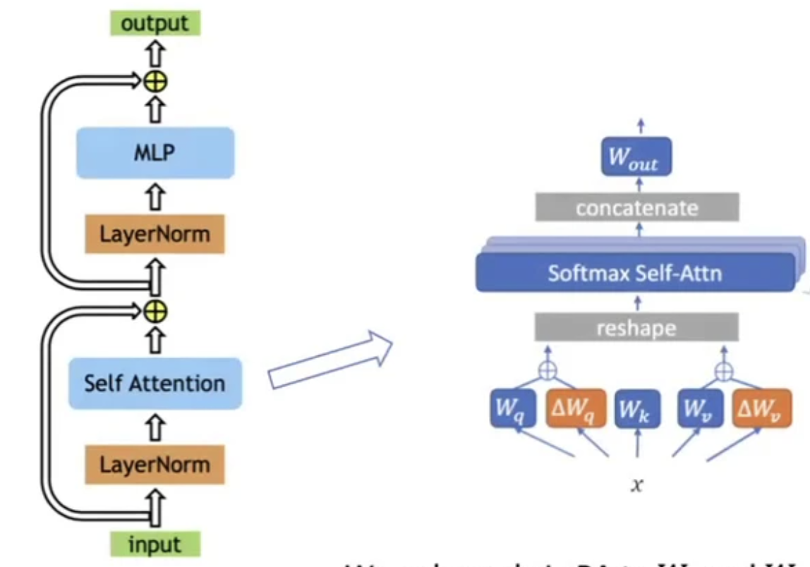
Low-Rank Adaptaion (Lora)
We only apply LoRA to W_{q} and W_{v} to reduce # of trainable parameters.

Slide 7
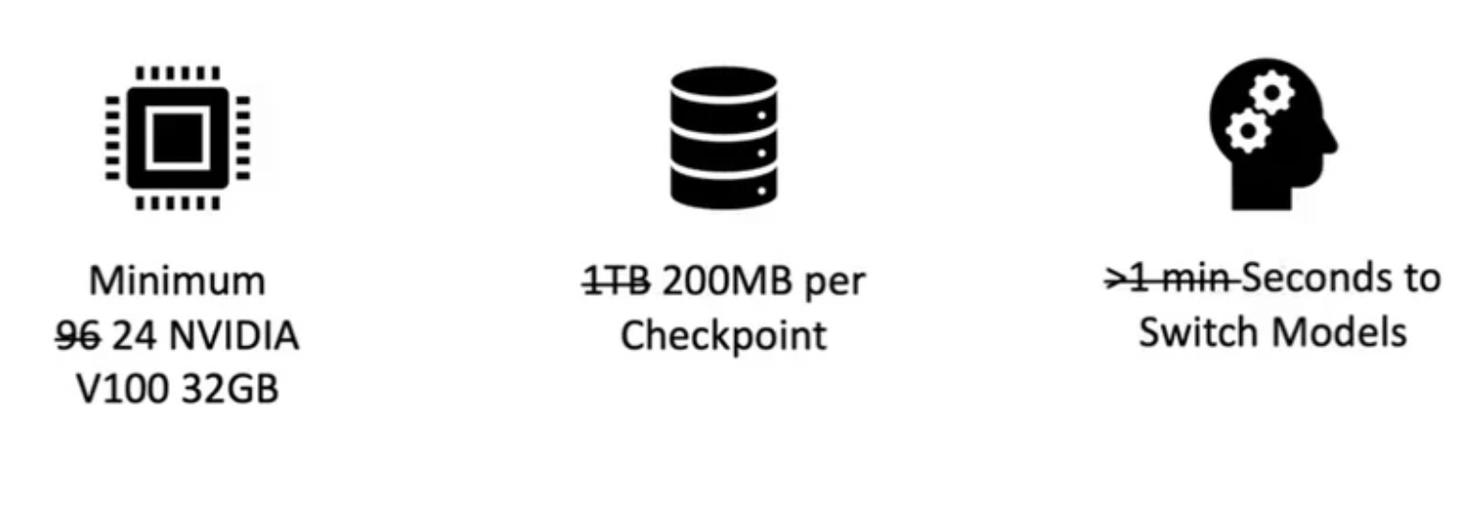
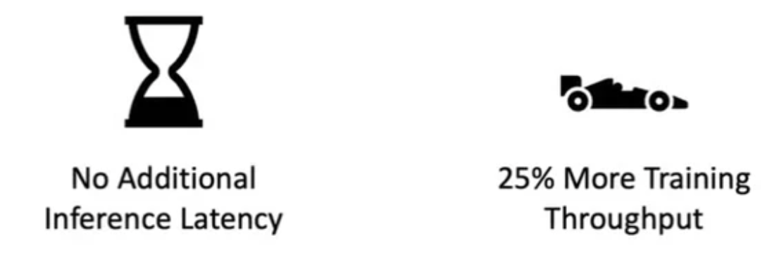
Fine-tune GPT-3 with Lora

Slide 8
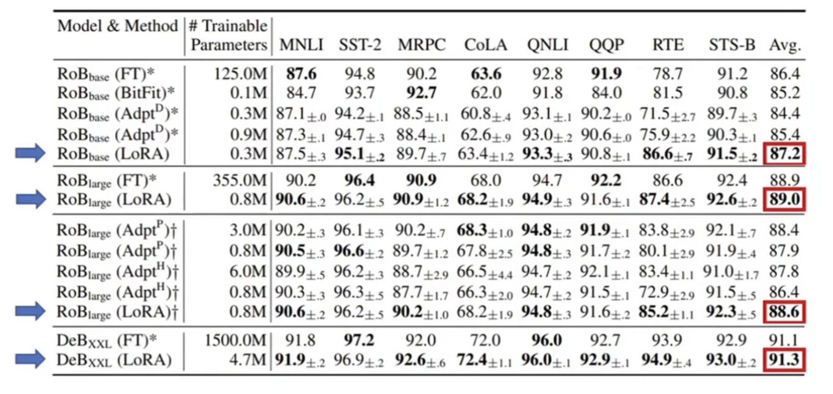
Perfermance on GLUE
AdapterD – AdapterDrop: On the Efficiency of Adapters in Transformers, Rücklé et al. 2020
AdapterP – AdapterFusion: Non-Destructive Task Composition for Transfer Learning, Pfeiffer et al. 2020
AdapterH – Parameter-Efficient Transfer Learning for NLP, Houlsby et al. 2019

Slide 9
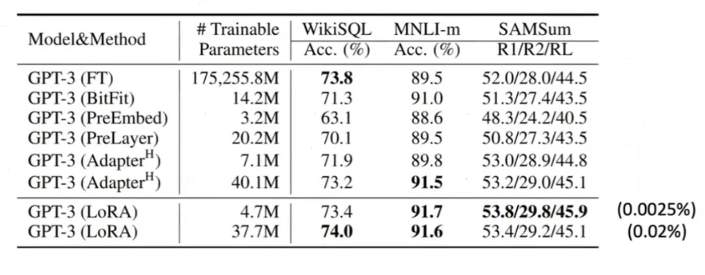
Perfermance on GPT-3
AdapterH – Parameter-Efficient Transfer Learning for NLP, Houlsby et al. 2019

Slide 10
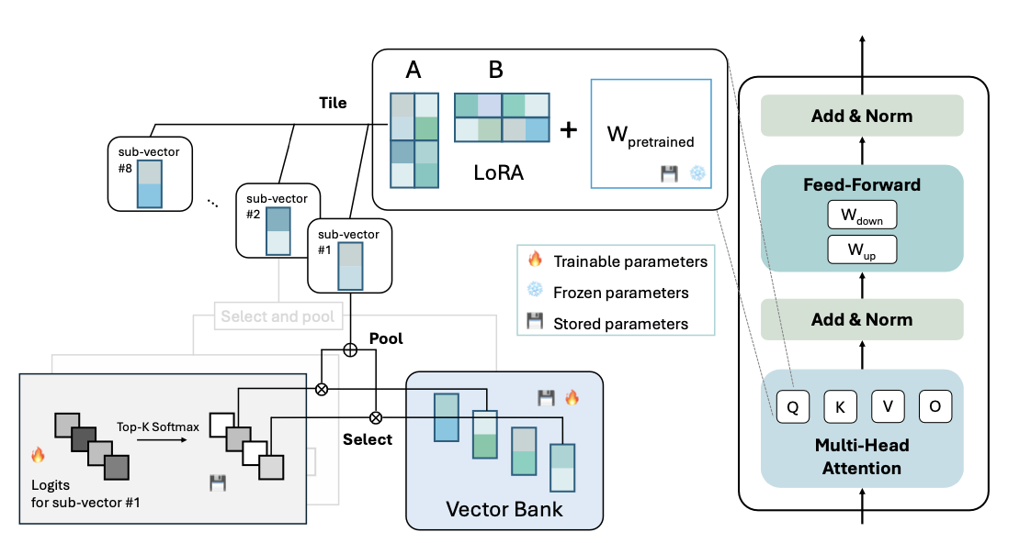
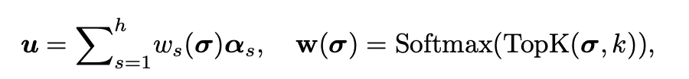
Vector Bank LoRA
We use a top-k softmax function to select k vectors from the vector bank. The selected vectors are then pooled into a sub-vector, which is arranged at a desired position, forming the parameters of LoRA.

Slide 11
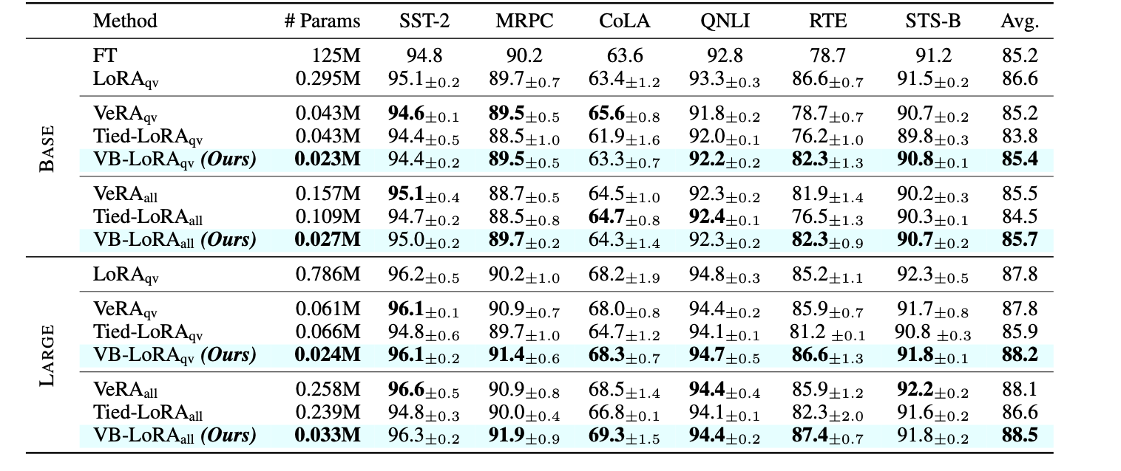
Performance of VBLora on Glue

Slide 12
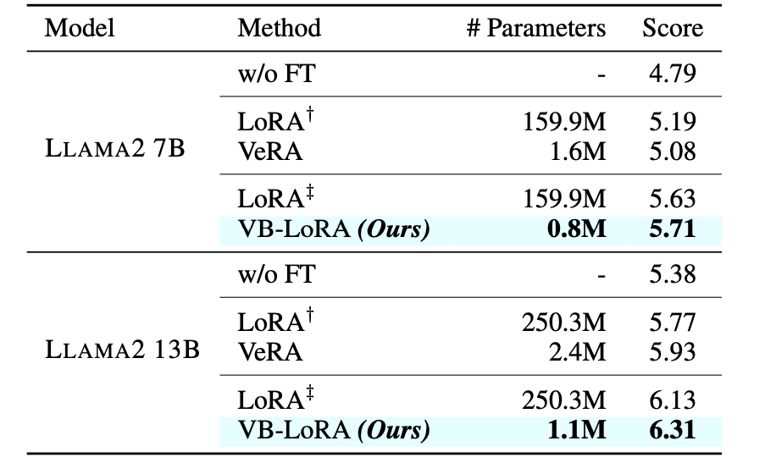
Performance of VBLora on LLAMA

Slide 13
Our method

Slide 14
Our method

Slide 15
Our method

Slide 16
Experiments
Task:Glue Mrpc Model:Robert-base
# Clients: 100 Communication Round: 1000. Local epoch:1 Client sampling rate: 0.1
 | Lora + FL w. Head | Lora + FL w.o. Head | Ours w. Head | Ours w.o.Head
Communication Cost | 2641.18 MB | 1.18MB | 2640.092 MB | 0.092MB
F1 Score | 0.902 | 0.906 | 0.906 | 0.909

Slide 17
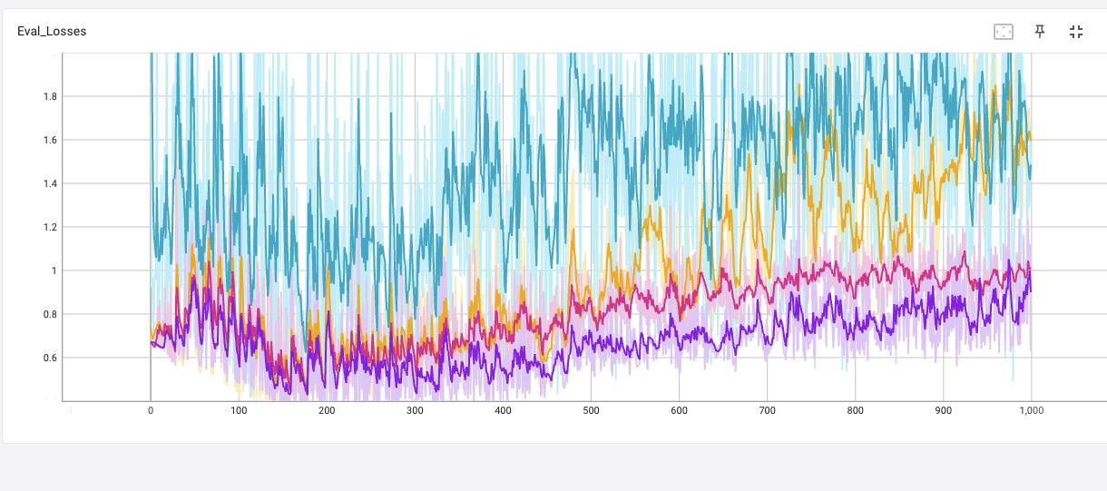
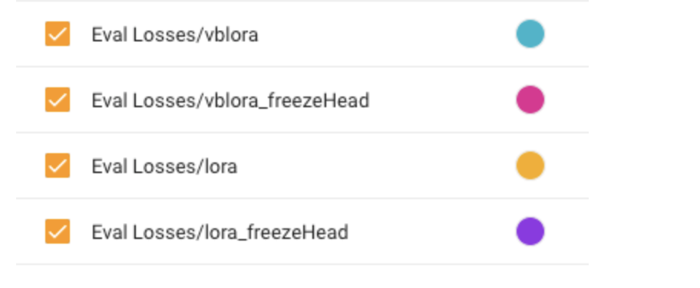
Experiments
Rate of convergence

Slide 18
Future work
Because our framework of Federated Learning is not exactly same with existing framework such as Fedavg and Fedprox. It is necesssary to prove our framework is convergence under some assumptions, following :
2020-ICLR-ON THE CONVERGENCE OF FEDAVG ON NON-IID DATA
2020-MLsys-FEDERATED OPTIMIZATION IN HETEROGENEOUS NETWORKS
Try to find a suitable initializing parameters method for our model following :
2024-ICLR- LoRA-GA: Low-Rank Adaptation with Gradient Approximation

Slide 19
Thank you!
Q&A

